Slide 1
DISK CLONING
WITH MINITOOL OFFLINE

Slide 2
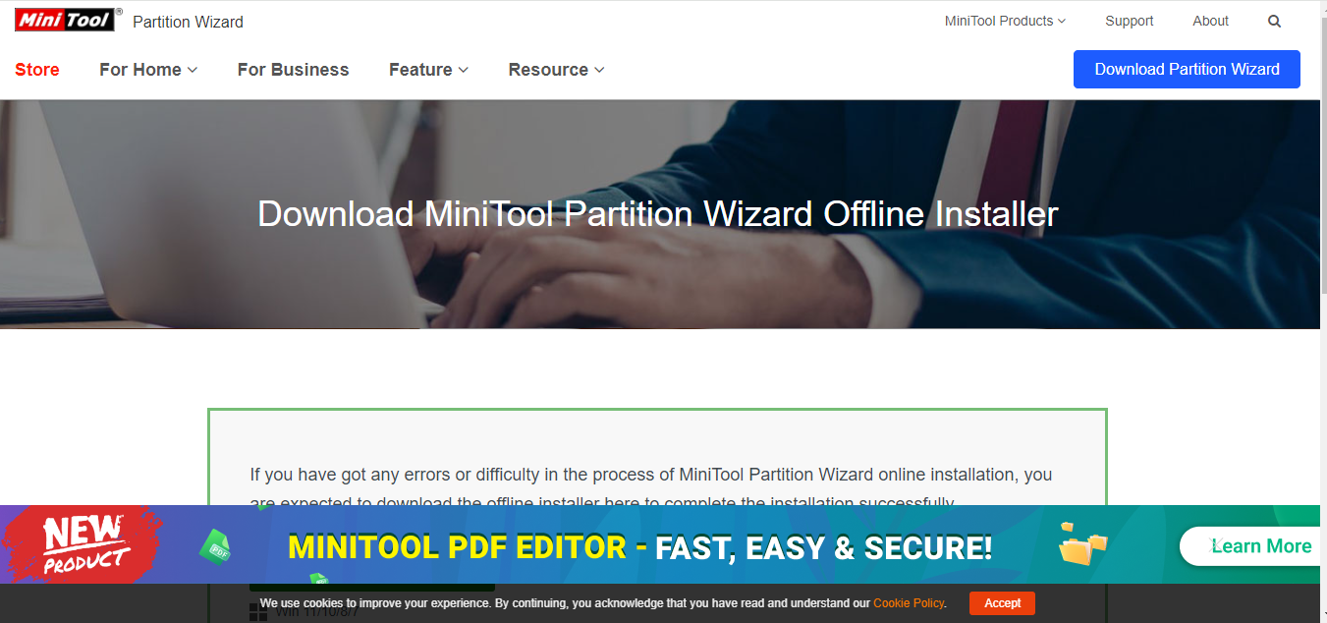
Step of cloning disk with minitool
You first have to go on google. You then type minitool offline
Why offline?
Sometimes you may not have access to the internet but you are stuck and you have to perform the cloning processes
Having the offline version of the software will enable you to run wherever and anytime you desire

Slide 3
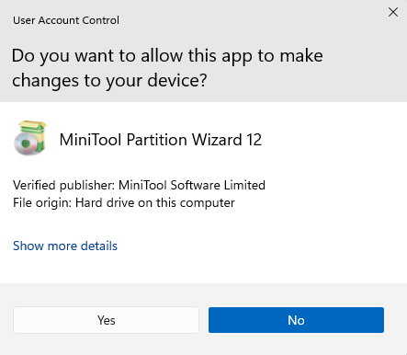
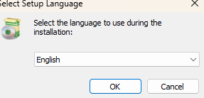
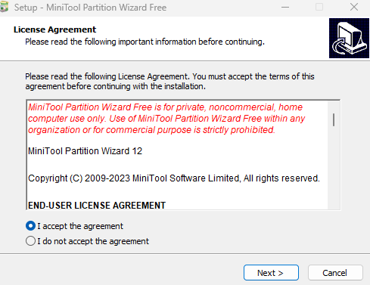
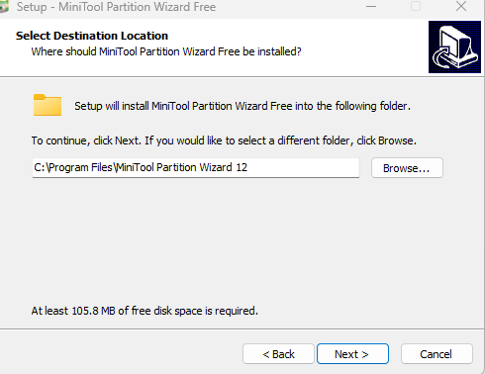
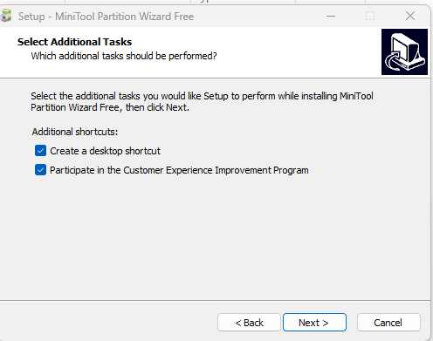
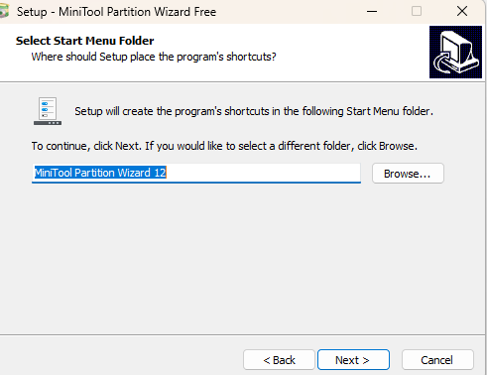
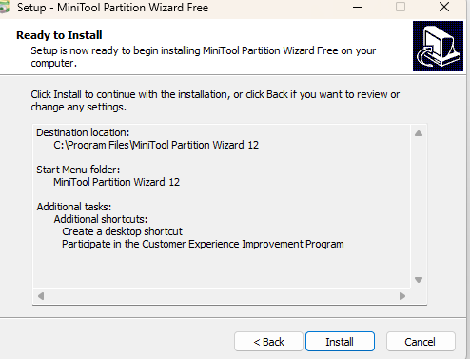
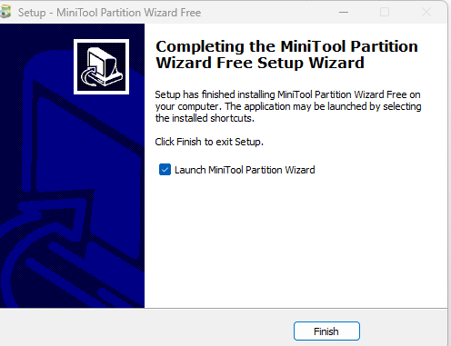
After downloading you will have to follow some steps in order to successfully install minitool offline

Slide 4
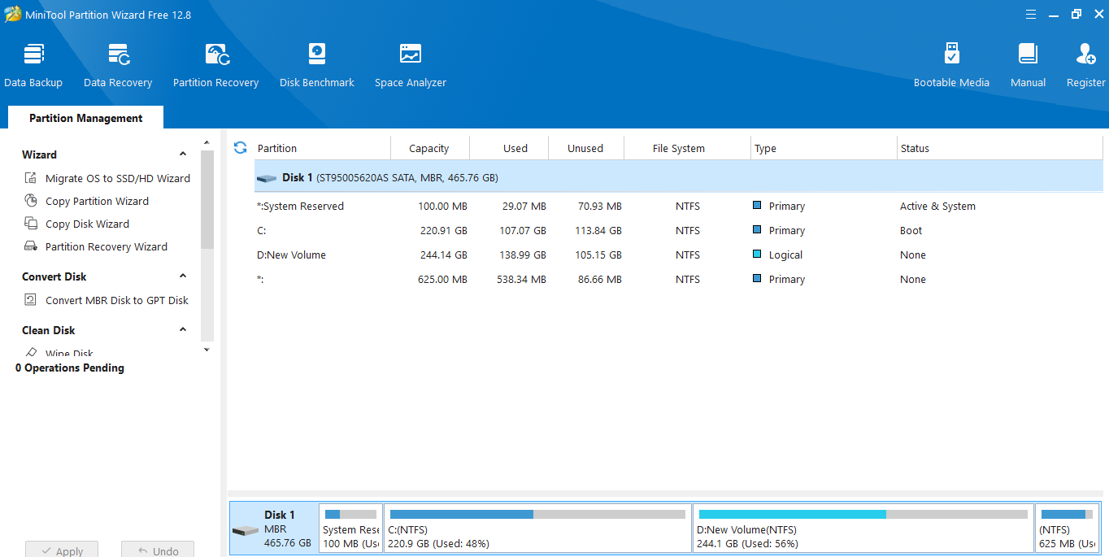
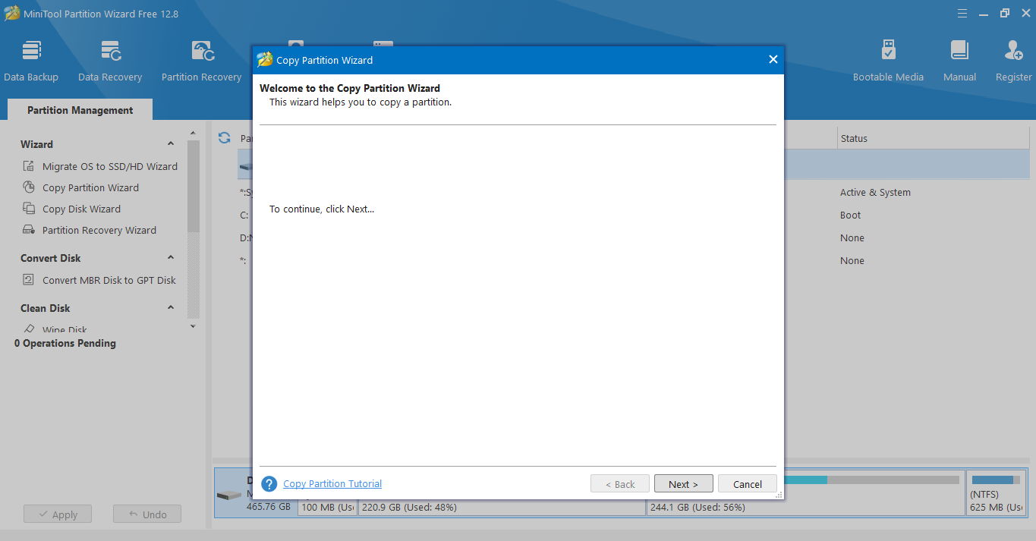
On the previous slide we have successfully installed minitool now we need to start the steps of cloning
Next ,click on copy partition wizard
click on NEXT

Slide 5
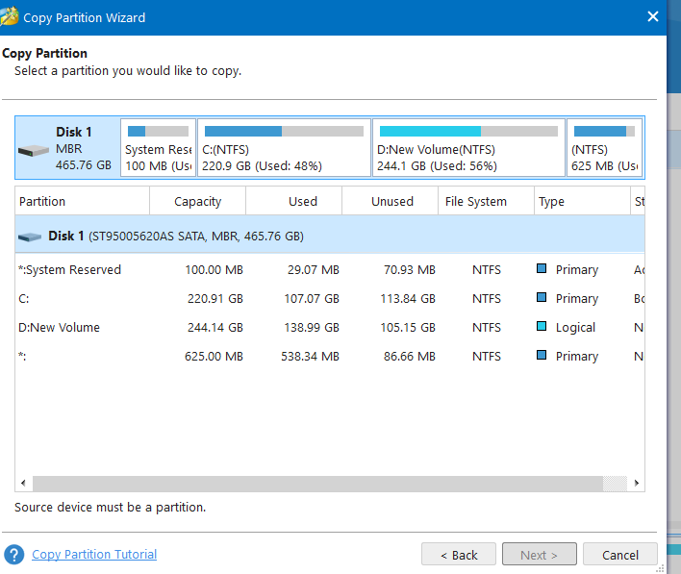
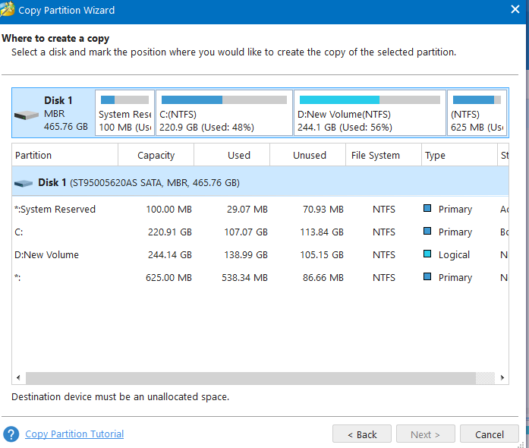
Here you have to click on the partition ,you would like to copy
For this case it is local disk c:
Next, you have to select the partition where you want to copy your local disk c:
You now have to make that partition unallocated that means you must format it

Slide 6
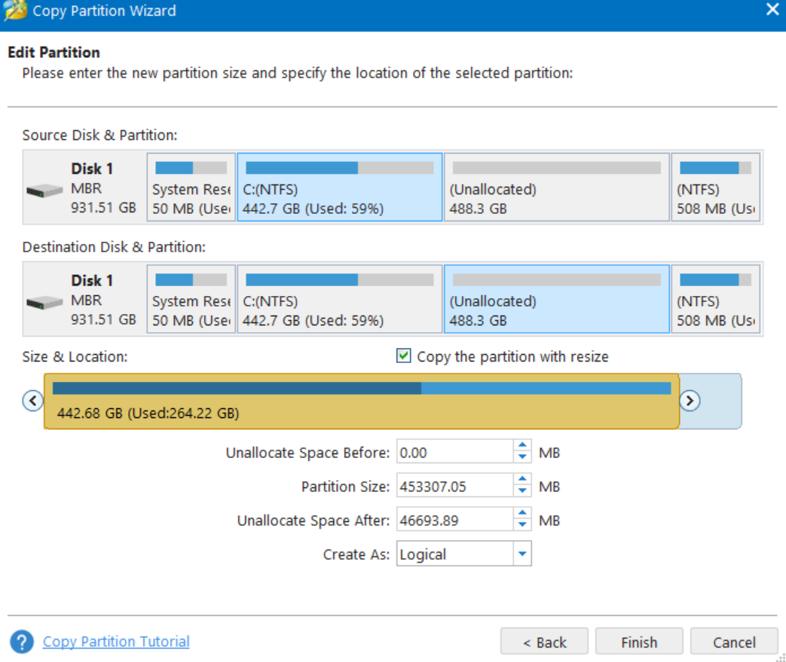
Here is the final step. You have to click on finish and apply to perform the clonning

